Slide 1
Project Title
Presented by : AKERELE Ifedayo David
Instructors : Oluwole Olajide, Blessing Olorunfemi, Isaac Oyekunle
Design and Deployment of an AI-Powered Predictive System
{7/6/2025}

Slide 2
Study Background
Student academic performance is a critical indicator of educational outcomes and success.
Traditional methods of assessing performance often rely on past grades without predictive insights.
Machine learning offers the ability to predict final outcomes using multiple features (e.g., attendance, family background, study habits).
Educational institutions can benefit from early predictions to support at-risk students.
The UCI Student Performance dataset provides rich real-world data for modeling.
This study AI to create a preusesdictive tool that forecasts final student grades (G3) based on historical and behavioral data.

Slide 3
Problem Statement
This project falls under the Education category. The key question addressed is:
"How can AI models be developed and deployed in real-world applications to support decision-making and improve task automation through a simple web interface?“
We aimed to predict students' final academic performance (G3) based on various personal, social, and academic features using a supervised machine learning model.

Slide 4
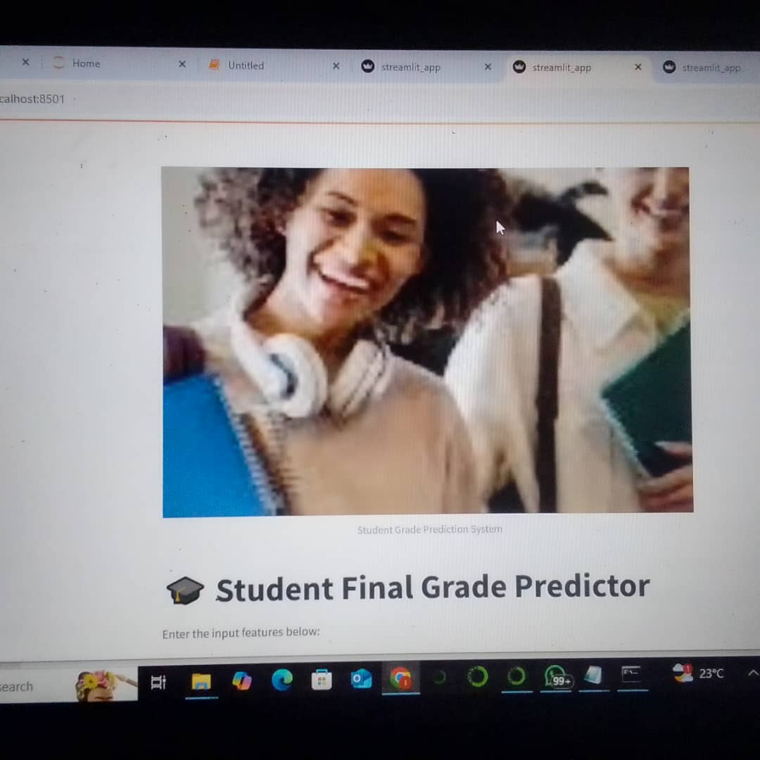
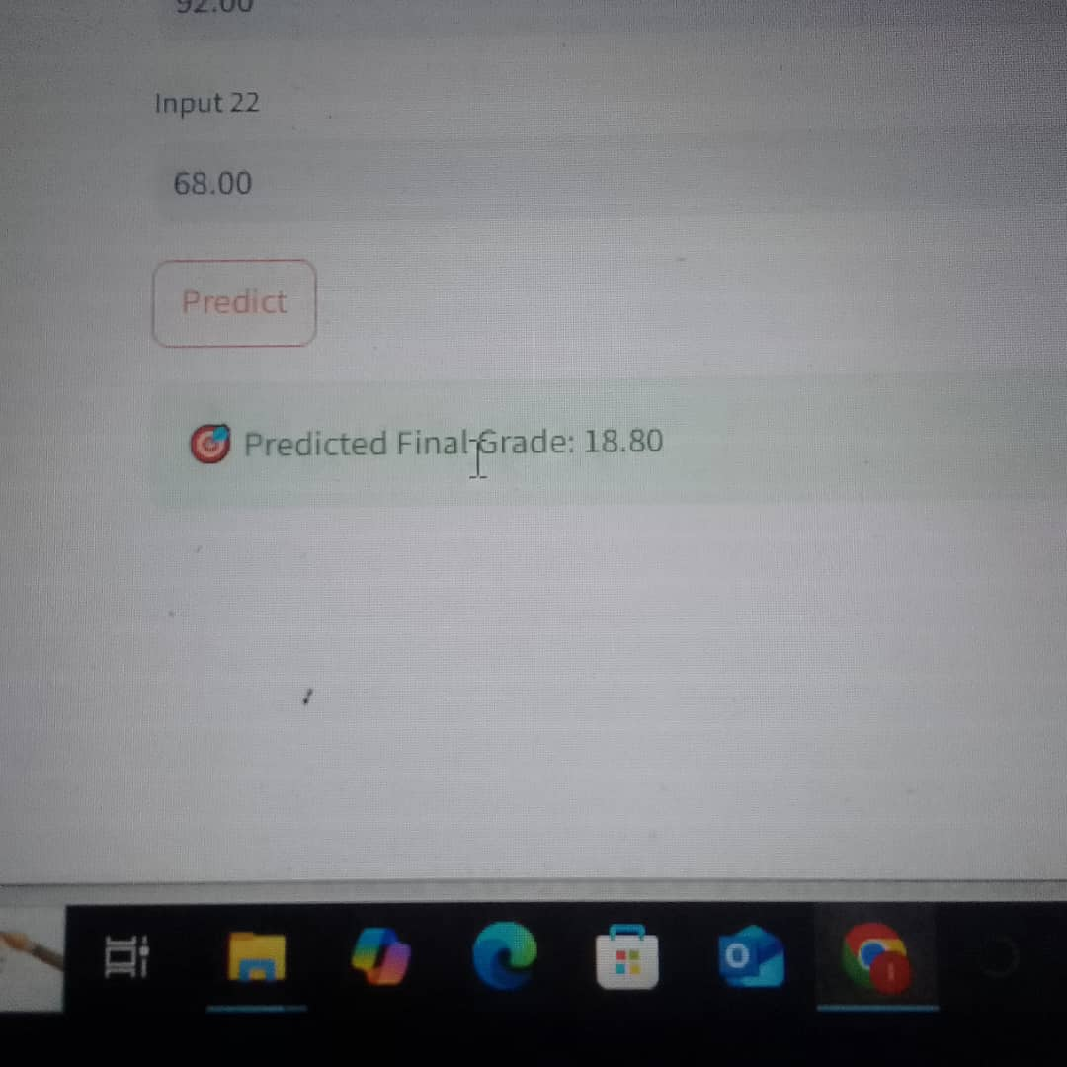
Aim and Objectives
Aim
Objectives

Slide 5
Materials and Methods
Materials
Dataset Source
📍 Source: UCI Machine Learning Repository
📂 Dataset: Student Performance Data Set
🔗 Link: https://archive.ics.uci.edu/ml/datasets/Student+Performance
Python and python libraries (Jupter notebook/Anaconda)
Streamlit

Slide 6
Methods
Data Preprocessing Steps
Loaded CSV data (student-mat.csv)
Parsed data using sep=";" to correct NaN issue
Cleaned the dataset:
Dropped irrelevant/weak features (guardian, famsize, romantic, etc.)
Converted categorical values using LabelEncoder
Performed Exploratory Data Analysis (EDA)
Split into features (X) and target (y = G3)
Split data into training and testing sets (80/20)
Metric | Score
MAE | ~1.5
RMSE | ~1.8
R² | ~0.89
📄 Web App Development (Streamlit)
Converted model to a deployable .pkl file using joblib
Developed user interface using Streamlit
Takes numeric input for all student features
Returns predicted final grade in real-time
Added banner image and customized input form
Ran the app locally with:
bash
streamlit run streamlit_app.py
Model Description & Evaluation
🔧 Model:
Type: Random Forest Regressor
Library: scikit-learn
🎯 Performance:
The model shows strong predictive ability and low error in predicting student grades.

Slide 7
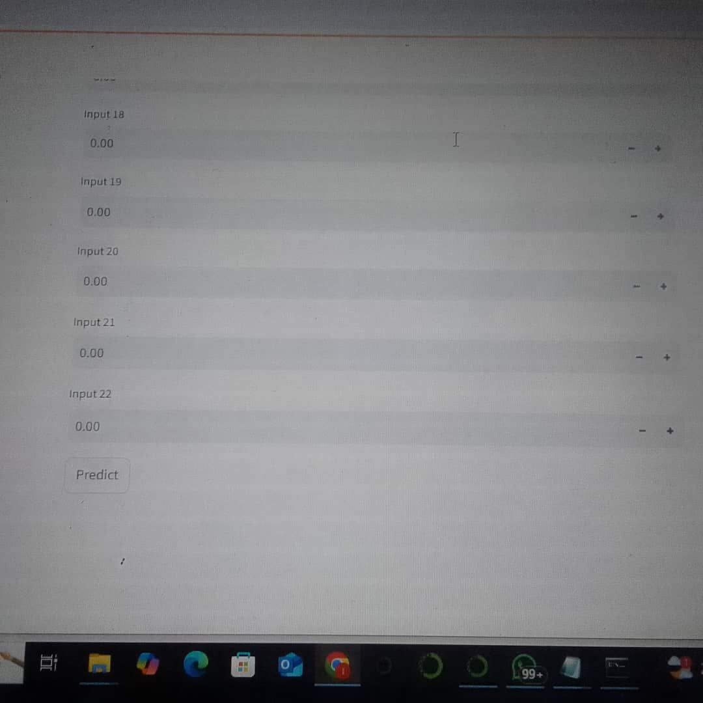
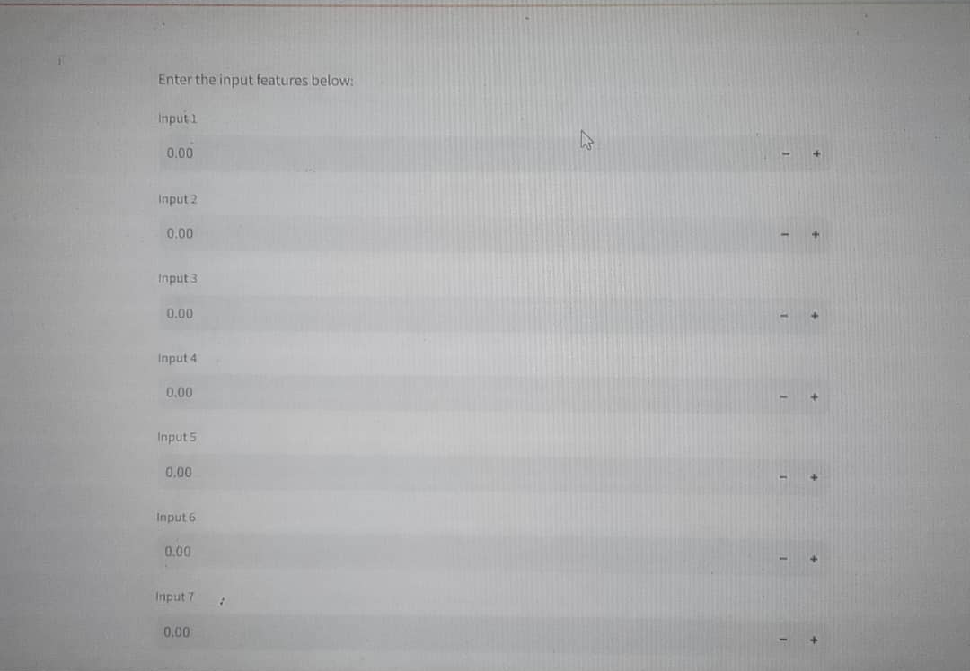
Results

Slide 8
Conclusion
This project successfully demonstrated how artificial intelligence can be applied to the education sector to enhance decision-making and improve learning outcomes.
By leveraging the UCI student performance dataset, we built a robust predictive model using supervised machine learning techniques.
The model accurately forecasts a student’s final grade (G3) based on various academic, personal, and social factors.
Deploying the model via a user-friendly Streamlit web app ensures that educators, administrators, and policymakers can easily access and utilize the prediction tool.
Overall, this AI-powered system has the potential to support early intervention strategies, promote personalized learning, and ultimately improve student success rates.

Slide 9
Thank You for Listening

